Slide 1


ST.JOSEPH COLLEGE OF ENGINEERING
DEPARTMENT OF INFORMATION TECHNOLOGY
2019-2023
Detection and Classification of Covid-19 using Deep Learning
PRESENTED BY
AJAY R (212919205003)
ARUNKUMAR A (212919205005)
SHERLIN A G (212919205043)
GUIDED BY
Mr. KARTHI S
Assistant Professor
Department of IT

Slide 2
ABSTRACT
Coronavirus disease is a fatal epidemic disease that is originated in Wuhan, China in December 2019.
This disease is diagnosed using radiological images taken with the help of basic scanning methods besides the test kits.
In this project we are using Residual Neural Network used for the detection of the novel corona virus disease – are also known as the COVID-19. through the chest scanning images.
Finally a public dataset containing COVID-19 and NON-COVID-19 classes was used to verify the validity whether it is present or not.
Chest CT imaging offers the benefits of quick reporting, a low cost, and high sensitivity for the detection of infection.

Slide 3
In order to meet the data requirements for COVID-19 CT imaging, we propose a CT image synthesis approach based on a conditional generative adversarial network that can effectively generate high-quality and realistic COVID-19 CT images for use in deep-learning based medical imaging tasks.
There are two main diagnostic approaches for COVID-19. RT-PCR and chest computed tomography (CT) imaging
However, the sensitivity of RT-PCR is relative low for COVID-19 testing . As an alternative, chest CT scans can be used to take tomographic images from the chest area at different angles with post-computed X-ray measurements.
This approach has a higher sensitivity to COVID-19 and is less resource-intensive than traditional RT-PCR.

Slide 4
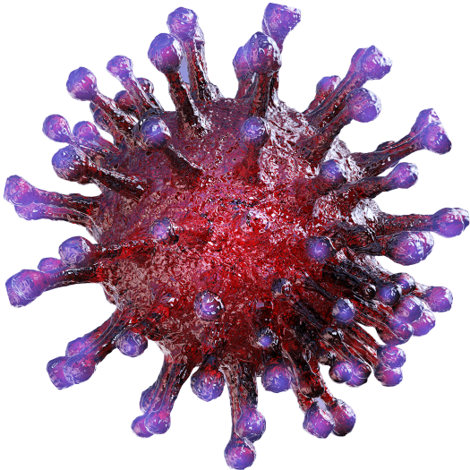
PROBLEM STATEMENT
Training a deep-learning model requires large volumes of data.
Medical staff faces a high risk when collecting COVID-19 CT image data due to the high infectivity of the disease.
Another issue is the lack of experts available for data labeling.
COVID-19 has been a severe health issue affecting the respiratory system and spreads very fast from one human to other overall countries.

Slide 5
EXISTING SYSTEM
RT-PCR: This is the most widely used diagnostic test for COVID-19 detection. It involves collecting a sample from the patient's nose or throat and testing it for the presence of the virus using reverse transcription polymerase chain reaction (RT-PCR) technology. This test is highly accurate but can take several days to get results.
Rapid antigen tests: These tests detect the presence of viral proteins in a nasal or throat swab. They are less accurate than RT-PCR tests.
There are also various existing systems for COVID-19 detection, including laboratory tests, imaging modalities, and AI-based systems.

Slide 6
PROPOSED SYSTEM
In this project we are using Residual Neural Network used for the detection of the novel corona virus disease – are also known as the COVID-19. through the chest scanning images.
Chest X-rays and CT scans: These imaging modalities can be used to detect characteristic features of COVID-19 such as ground-glass opacities and consolidations in the lungs. They are not as accurate as laboratory tests but can provide rapid results.
Chest X-rays and CT scans for COVID-19 detection. These systems can provide rapid and accurate results and have the potential to be used for mass screening.

Slide 7
LITERATURE SURVEY
COVID-19 Virus Detected using Real Time RT-PCR
Objectives: To optimize a plasmonic PCR system and perform rapid, one step RT- PCR for the samples.
Keywords: SARS, Coronavirus, Real-Time PCR, RT-PCR, TaqMan, cytokine
Real time RT–PCR is a nuclear-derived method for detecting the presence of specific genetic material in any pathogen, including a virus. Originally, the method used radioactive isotope markers to detect targeted genetic materials, but subsequent refining has led to the replacement of isotopic labelling with special markers, most frequently fluorescent dyes. This technique allows scientists to see the results almost immediately while the process is still ongoing, whereas conventional RT–PCR only provides results at the end of the process. Real time RT–PCR is one of the most widely used laboratory methods for detecting the COVID-19 virus.

Slide 8
Deep Learning
Deep learning is a subfield of machine learning that focuses on the development and application of artificial neural networks, particularly deep neural networks with multiple layers.
Deep learning has emerged as a powerful technique for COVID-19 detection, offering the potential to assist medical professionals in accurately identifying and diagnosing the disease.
Deep learning models, particularly convolutional neural networks (CNNs), have been applied to various medical imaging modalities, such as chest radiographs, computed tomography (CT) scans, and even X-ray images, to aid in COVID-19 detection.

Slide 9
Here's how deep learning is utilized for COVID-19 detection:
Data Collection
Preprocessing
Model Architecture Selection
Training the Data
Validating the Data
Testing and Evaluation
Deployment

Slide 10
SYSTEM ARCHITECTURE
Pre-processing
Image augmentation
Lung lobe segmentation
Input CT scan image
Adaptive bilateral filter
Rotation, Shifting, Flipping and Zooming
Feature extraction
Lung lesion segmentation
Residual Neural Network
(ResNet)
CNN
Positive
Gradient Descent
Confusion matrix
Negative

Slide 11
MODULES
Image Pre-Processing
Image Augmentation
Lung Lobe Segmentation
Lung Lesion Segmentation
Feature Extraction

Slide 12
Image Pre-Processing
In pre-processing, the input lung CT image is being processed to enhanced image quality. The various pre-processing technique is used to reduced noise effect and blurring effect.
The better quality measurements are depends on the various methods.
Top-hat transform
Median Filter
Adaptive Bilateral Filter
For the present study, pre-processing of original sample image to reduce noise detection and gaussian blur using adaptive bilateral filter, by comparing Adaptive bilateral filter is best method to find better accurate rate.
The mean-square error (MSE) and the peak signal-to-noise ratio (PSNR) are used to compare image compression quality.

Slide 13
Adaptive Bilateral Filter
An adaptive bilateral filter is a type of image filtering technique that is commonly used in medical imaging, including CT (computed tomography) scans.
The goal of the filter is to reduce noise and improve image quality, making it easier for medical professionals to analyze and interpret the images.
The adaptive bilateral filter is particularly effective for CT scans because it can adapt to the specific noise characteristics of each image, making it a versatile tool for improving image quality.
Overall, the adaptive bilateral filter is a powerful tool for improving image quality in CT scans, which can ultimately lead to more accurate diagnoses and better patient outcomes.

Slide 14
Image Augmentation
Scaling: The image can be scaled up or down to simulate different resolutions or magnifications. Increase or decrease the picture size.
Rotation: The image can be rotated by a certain angle to increase the diversity of the dataset.
Flipping: The image can be flipped horizontally or vertically to generate mirrored versions of the original images. Flip the image left, right, or upside down.
Cropping: The image can be cropped to focus on specific regions of interest within the image.
Zooming: Zoom In/Out.

Slide 15
Lung Lobe Segmentation
Coronavirus is a disease that affects the lung area. Lung segmentation has a significant function in assessing lung disorders.
The process of segmentation has seen widespread use of deep learning algorithms. The U-Net is one of the most significant semantic segmentation frameworks for a convolutional neural network(CNN).
Proposing U-Net architecture is evaluated on 565 datasets divided into 500 training images and 65 validation images, For chest X-ray and CT images.
The findings of the experiments demonstrate that the suggested strategy successfully achieved competitive outcomes with 91.47% and 89.18% accuracy, for training and validation images, respectively.

Slide 16
Feature Extraction
Using CNNs, feature extraction involves identifying and extracting relevant features from medical images (e.g., chest X-rays or CT scans) that can be used to train a CNN model to accurately distinguish COVID-19 from other respiratory diseases.
One common approach is to use transfer learning, where a pre-trained CNN model is used as a feature extractor.
Using LDP, preprocess the COVID-19 images to remove noise, enhance contrast, and normalize the intensity values. This step will improve the accuracy of feature extraction.

Slide 17
Convolutional Neural Networks (CNNs)
A convolutional neural network (CNN) is a type of deep learning algorithm commonly used for image analysis.
Convolutional neural networks (CNNs) have been widely applied to analyze CT scan images in medical imaging.
They have shown to be effective in tasks such as image classification, segmentation, and detection of abnormalities.
In CT scans, CNNs can be used to identify and classify different structures and tissues based on their intensity values, shapes, and spatial relationships. For example, in lung CT scans, CNNs can be used to identify lung nodules or masses

Slide 18
Residual Neural Network
ResNet (Residual Neural Network) is a deep learning architecture that has been widely used in various computer vision tasks, including the detection and classification of medical conditions. In the context of COVID-19 detection, ResNet has shown promising results.
ResNet is known for its ability to effectively train very deep neural networks. It addresses the challenge of training deep networks by introducing skip connections or residual connections. These connections enable the network to learn residual mappings, allowing for easier optimization and better gradient flow during the training process.
When applied to COVID-19 detection, ResNet can be used as a powerful tool for analyzing chest radiographs or computed tomography (CT) scans

Slide 19
Medical professionals have used chest imaging to identify and characterize COVID-19-related lung abnormalities, such as ground-glass opacities, consolidation, and other signs of pneumonia.
By leveraging the deep learning capabilities of ResNet, researchers and data scientists have developed models that can automatically detect COVID-19-related abnormalities in chest images.
These models are trained on large datasets of labeled chest radiographs or CT scans, including both COVID-19 positive and negative cases.
The training process involves feeding the labeled images into the ResNet model, which learns to extract relevant features and patterns indicative of COVID-19 infection. The model then goes through an iterative optimization process to minimize the prediction errors and improve its performance.

Slide 20
Gradient Descent
Gradient descent is an optimization algorithm commonly used in machine learning and deep learning to minimize the error or loss function of a model during training.
Although gradient descent itself is not specific to COVID-19, it plays a crucial role in training models used for COVID-19-related tasks, such as disease prediction or analysis.
In the context of COVID-19, gradient descent can be used to train machine learning or deep learning models on COVID-19 datasets, allowing the models to learn patterns and make accurate predictions.

Slide 21
Confusion Matrix
In the case of COVID-19 detection, a confusion matrix can be used to evaluate the performance of a machine learning model that predicts whether a patient has COVID-19 or not.
A confusion matrix for COVID-19 detection typically has four elements:
True Positive (TP): The model correctly predicts that a patient has COVID-19.
False Positive (FP): The model incorrectly predicts that a patient has COVID-19 when they do not.
True Negative (TN): The model correctly predicts that a patient does not have COVID-19.
False Negative (FN): The model incorrectly predicts that a patient does not have COVID-19 when they do.

Slide 22
Example of a confusion matrix for COVID-19 detection:
 | Predicted Positive | Predicted Negative
Actual Positive | TP | FN
Actual Negative | FP | TN

Slide 23
Software Used
LANGUGE USED : PYTHON, JAVASCRIPT
DOMAIN : DEEP LEARNING
GOOGLE COLAB, VISUAL STUDIO
PYTHON VERSION 3.7.0
MINIMUM REQUIREMENTS
OS = windows 10 or more
RAM = 8 GB or more
ROM = More than 100 GB
CPU = 1.7 GHz

Slide 24
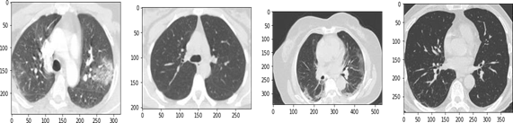
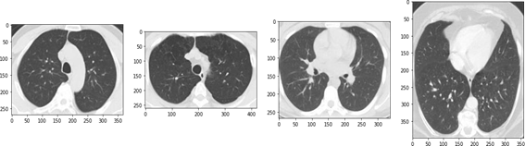
INPUT CT-IMAGES

Slide 25
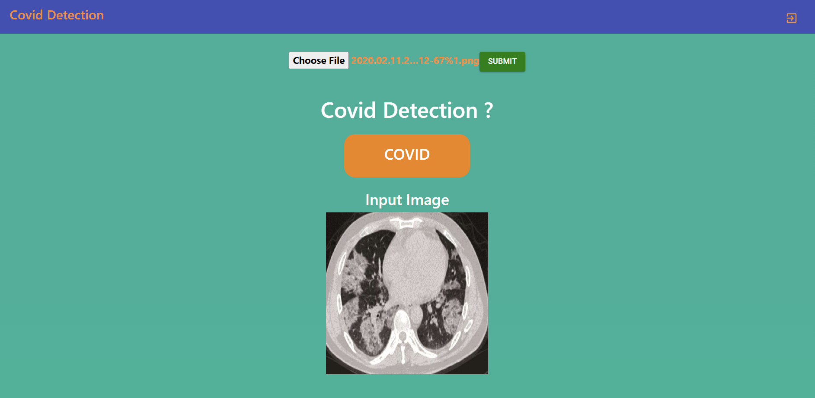
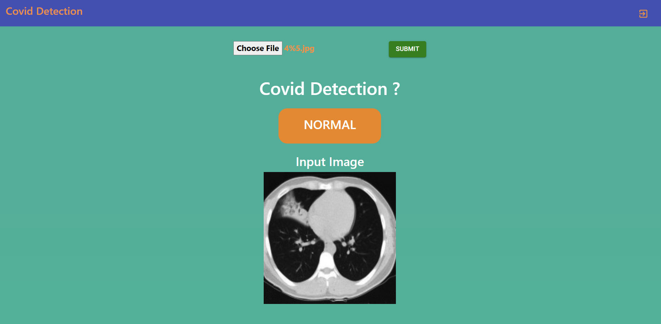
OUTPUT
WHETHER COVID -19 IS
POSITIVE or NEGATIVE

Slide 26


